Slide 1

Search-based Path Planning with
Homotopy Class Constraints
Subhrajit Bhattacharya
Vijay Kumar
Maxim Likhachev
University of
Pennsylvania
GRASP
LABORATORY

Slide 2
Addendum
For the simple cases in 2-dimensions we have not distinguished between homotopy and homology. The distinction however does exist even in 2-d. See our more recent [AURO 2012] paper or [RSS 2011] paper for a comprehensive discussion on the distinction between homotopy and homology, examples illustrating the distinction, and its implications in robot planning problems.
[AURO 2012] Subhrajit Bhattacharya, Maxim Likhachev and Vijay Kumar (2012) "Topological Constraints in Search-based Robot Path Planning". Autonomous Robots, 33(3):273-290, October, Springer Netherlands. DOI: 10.1007/s10514-012-9304-1.
[RSS 2011] Subhrajit Bhattacharya, Maxim Likhachev and Vijay Kumar (2011) "Identification and Representation of Homotopy Classes of Trajectories for Search-based Path Planning in 3D". [Original title: "Identifying Homotopy Classes of Trajectories for Robot Exploration and Path Planning"]. In Proceedings of Robotics: Science and Systems. 27-30 June.

Slide 3
Homotopy Classes
Definition
Motivational Example
Trajectories in different homotopy classses
Trajectories in same homotopy classses
Deploying multiple agents for:
Searching/exploring the map
Pursuing an agent with uncertain paths
final
goal
?
?
Other applications:
?
initial
?
start
Path prediction
Avoid or visit certain homotopy classes

Slide 4
Approaches in literature for
representing Homotopy Classes
Geometric approach [Hershberger et al.; Grigoriev et al.]
Not well-suited for graph representation
Inefficient for planning with homotopy class constraints
Triangulation based method [Demyen et al.]
Not suitable for non-Euclidean cost functions
Requires triangulation-based discretization schemes.
Complexity increases significantly if environment contains many small obstacles .
Cannot be easily used with an arbitrary graph search and arbitrarily discretization.

Slide 5
Our Goal
Plan for optimal cost paths, cost being any arbitrary cost function (not necessarily Euclidean distances).
Avoid certain homotopy classes or constrain to certain homotopy classes – homotopy class constraints.
Derive an efficient representation of homotopy classes
Efficiently plan in arbitrary discretization and graph representation (Uniform discretization, unstructured discretization , triangulation, visibility graph, etc.)
To be able to use any standard graph search algorithm (Dijkstra’s, A*, D*, ARA*, etc.).
Our approach: Exploit theorems from Complex analysis –
Cauchy Integral Theorem and Residue Theorem

Slide 6
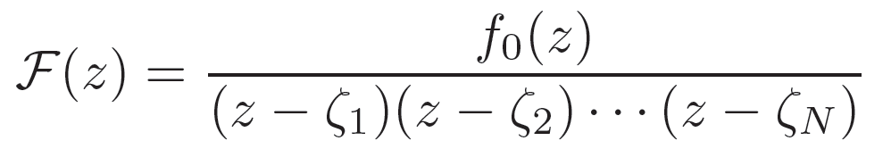
Basic Concept
(Construction)
f₀ , for example, can be any arbitrary polynomial in z
Im
ζ₁
ζ₂
ζ₃
Define an Obstacle Marker function such that it is Complex Analytic everywhere,
except for having poles (singularities)
at the representative points
Re
Represent the X-Y plane by a complex plane
i.e. A point (x,y) is represented as z = x + iy
Complex Analytic Function ≡
Complex Differentiable Functions:
F(z) ≡ F (x + iy) ≡ u(x, y) + i v(x, y)
Equivalently, F ( ) = ( )
with u, v following certain properties ( ²u = ²v = 0)
which are guaranteed when x & y are implicitly used
within z in construction of F.
Place “representative points”, ζ_{i}, inside significant obstacles
x
u(x,y)
y
v(x,y)

Slide 7
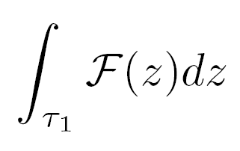
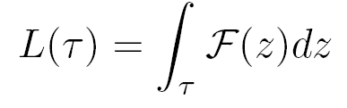
Basic Concept
(Properties of Complex Analytic functions)
A direct consequence of Cauchy Integral Theorem and Residue Theorem
Im
τ₁
τ₂
ζ₁
ζ₂
τ₃
=
≠
ζ₃
τ₁
τ₂
τ₃
Re
But the singularities lie on the obstacles!!
The value of uniquely defines
the homotopy class of a trajectory τ

Slide 8

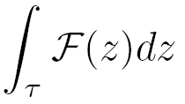
Switching to a Discretized Perspective
A trajectory in a discretized setting,
is nothing but a path in the graph
ζ₁
τ
∑
=
ζ₂
edge e
e
in path τ
ζ₃
An integration along a path in the graph
is nothing but
summation of the values of L(e) of the edges e along that path
z₂
L(z_{start}→z₂) = L(z_{start}→z₂) + L(e)
z₁
e
Turns out, L(e) can be computed efficiently
using a closed-form analytical expression.
(more details in paper)
Child node
z_{start}
Parent node

Slide 9


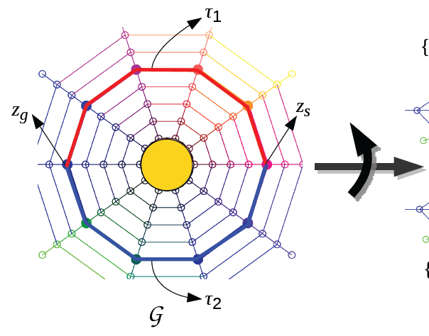
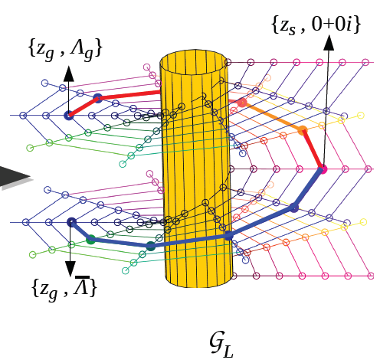
Graph Construction
(The L-augmented graph)
Given the graph laid upon the environment,
we construct,
Insight into graph topology:
z in G
{z, L(z_{s}→z)} in G _{L}
z₂
More details on Graph construction in paper
e₁
e₃
start
ζ₁
unique goal state
z_{s}
z_{g}
e₂
e₄
G
z₁
(z₂ , L(e₁))
e₁
e₃
(z_{g} , L(e₁)+L(e₃))
start
ζ₁
≠
(z_{s} , 0+0i)
(z_{g} , L(e₂)+L(e₄))
e₂
e₄
G _{L}
Goal states being distinguished by homotopy class of path taken to reach it
(z₁ , L(e₂))

Slide 10


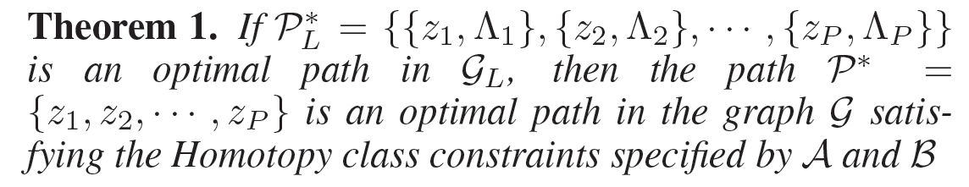
Theoretical guarantee
Homotopy Class Constraint
Set denotes the set of L-values of allowed homotopy classes
Set denotes the set of L-values of blocked homotopy classes
L
L
L

Slide 11
Implementation details
Small obstacles
We can ignore small obstacles or potential noise (incorrect reading from sensor data) by choosing not to put a ζ on an obstacle.
Single search for finding least cost paths in different homotopy classes
We can perform a single graph search to achieve this by continued expansion of states.
Im
ζ₁
ζ₂
ζ₃
Re

Slide 12
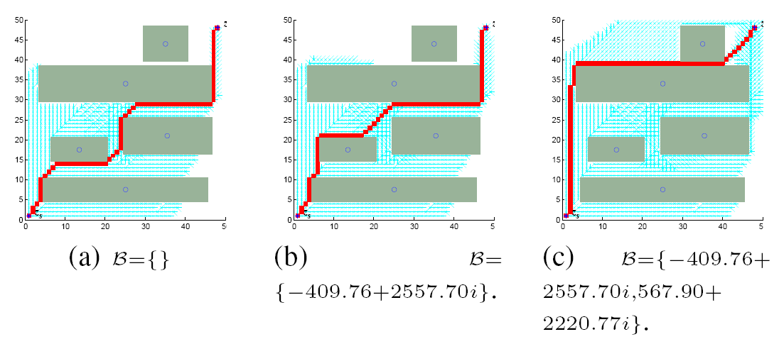
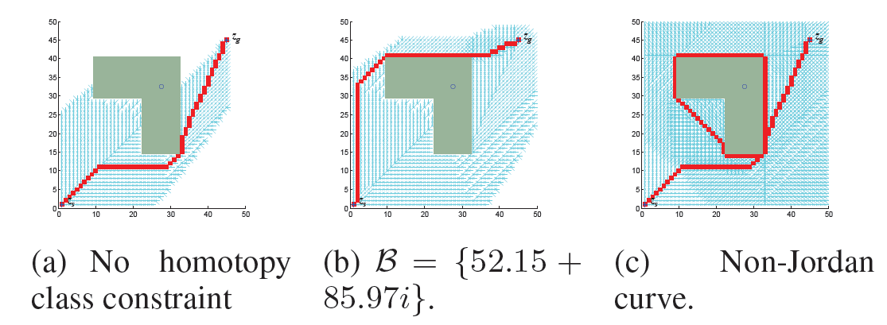
Experimental Results for 8-connected Grid
(Homotopy class exploration)

Slide 13
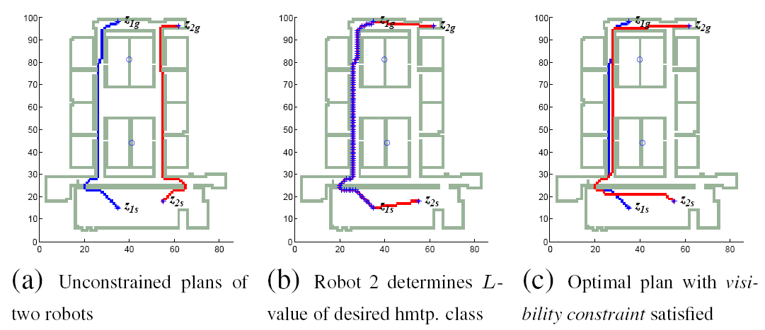
Results
(“Visibility” constraint translates to
homotopy class constraint)

Slide 14

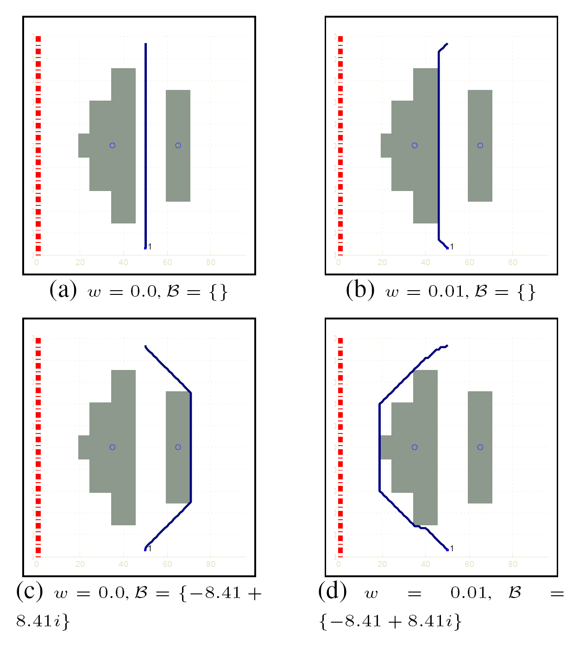
Results
(Non-Euclidean Cost function)

Slide 15
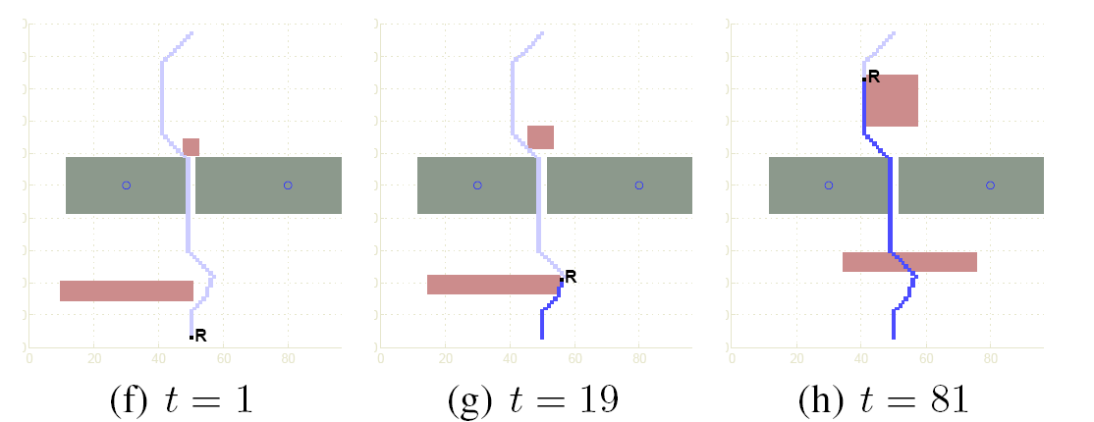
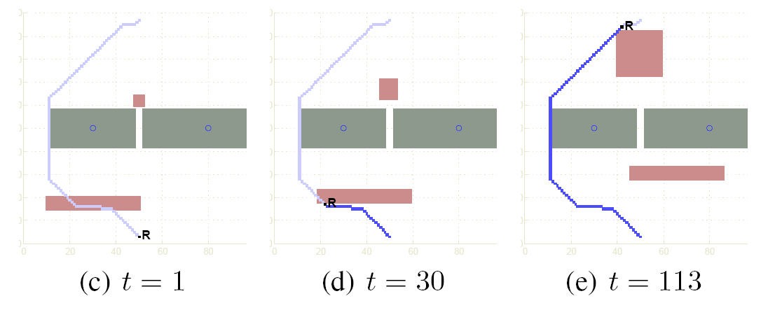
Results
(Planning with additional coordinates)
Planning in X-Y-Time
Planning in dynamic environment without homotopy class constraint
Planning in dynamic environment with a homotopy class blocked
Homotopy classes defined by taking projection on X-Y plane

Slide 16
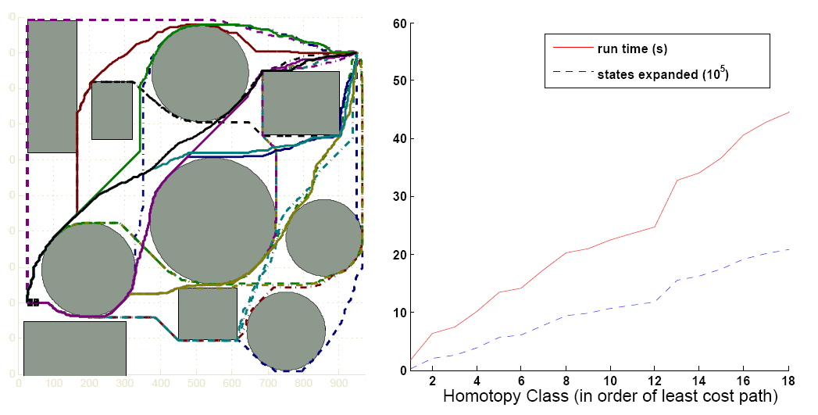
Results
(Demonstrating efficiency and scalability)
Exploring 20 homotopy classes in a
1000x1000 uniformly discretized environment
Time required for finding all the 20 homotopy classes < 50 seconds

Slide 17
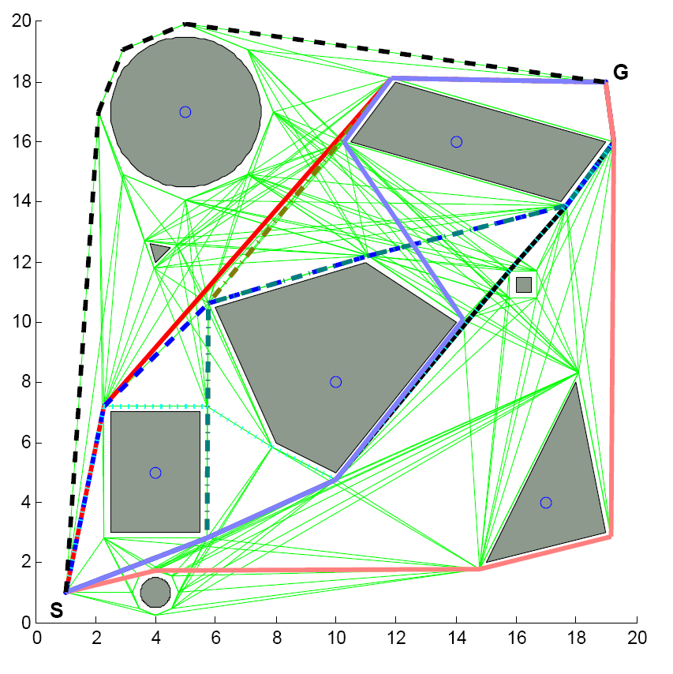
Results
(Implementation on a Visibility Graph)

Slide 18
More interesting results in paper

Slide 19
Conclusions
We have developed a compact and efficient representation of homotopy classes, using which homotopy class constraints can be imposed on existing graph search-based planning methods.
Future directions
Extend this method for planning in higher dimensions
Apply the technique for solving more real-life robotics problems

Slide 20
Acknowledgements
We gratefully acknowledge support from
ONR, NSF, ARO, ARL
Codes available at
http://fling.seas.upenn.edu/~subhrabh/
cgi-bin/wiki/index.php?n=Projects.RoboticsAIAutomation-DistributedPlanning
Thank you!
Questions?

