Slide 1
Addendum
For the simple cases in 2-dimensions we have not distinguished between homotopy and homology. The distinction however does exist even in 2-d. See our more recent [AURO 2012] paper or [RSS 2011] paper for a comprehensive discussion on the distinction between homotopy and homology, examples illustrating the distinction, and its implications in robot planning problems.
[AURO 2012] Subhrajit Bhattacharya, Maxim Likhachev and Vijay Kumar (2012) "Topological Constraints in Search-based Robot Path Planning". Autonomous Robots, 33(3):273-290, October, Springer Netherlands. DOI: 10.1007/s10514-012-9304-1.
[RSS 2011] Subhrajit Bhattacharya, Maxim Likhachev and Vijay Kumar (2011) "Identification and Representation of Homotopy Classes of Trajectories for Search-based Path Planning in 3D". [Original title: "Identifying Homotopy Classes of Trajectories for Robot Exploration and Path Planning"]. In Proceedings of Robotics: Science and Systems. 27-30 June.

Slide 2
GRASP
Search-based Path Planning with Homotopy Class Constraints
University of Pennsylvania
LABORATORY
Subhrajit Bhattacharya Vijay Kumar Maxim Likhachev
Definition
Motivational Example
Trajectories in different homotopy classses
Trajectories in same homotopy classses
Deploying multiple agents for:
Searching/exploring the map
Pursuing an agent with uncertain paths
Other applications:
Predicting possible paths of an agent with uncertainty in behaviors
Avoid high-risk regions and homotopy classes
Follow a known homotopy class in order to perform certain tasks

Slide 3
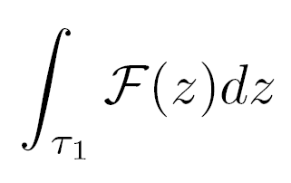
To plan for optimal cost paths (cost being any arbitrary cost function) within a particular homotopy class or to avoid certain homotopy classes.
With Efficient representation of homotopy classes and efficient planning in arbitrary graph representations and using any standard graph search algorithm.
Goal:
Homotopy class constraint
Our approach: Exploit theorems from Complex analysis – Cauchy Integral Theorem and Residue Theorem
Im
ζ₁
Consequence:
ζ₂
τ₁
τ₂
ζ₃
Define an Obstacle Marker function such that it is Complex Analytic everywhere, except for the representative points
τ₃
Re
Represent the X-Y plane by a complex plane
=
≠
τ₁
τ₁
τ₁
Place “representative points” in significant obstacles
The complex line integral of are equal along trajectories in the same homotopy class, while they are different along trajectories in different homotopy classes.

Slide 4
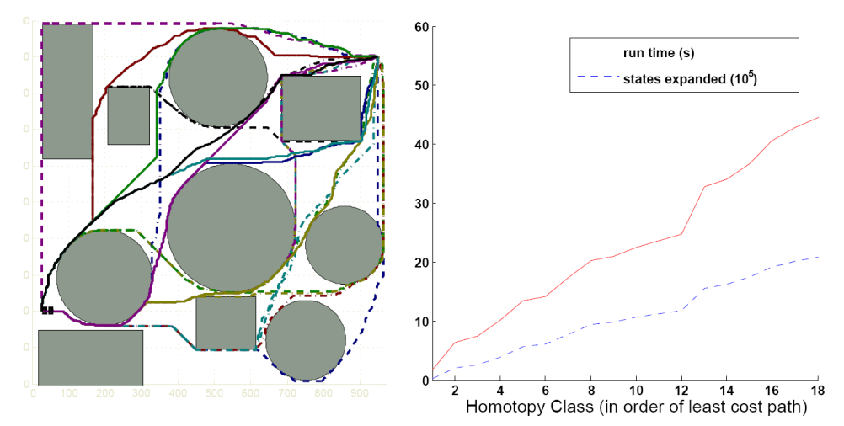
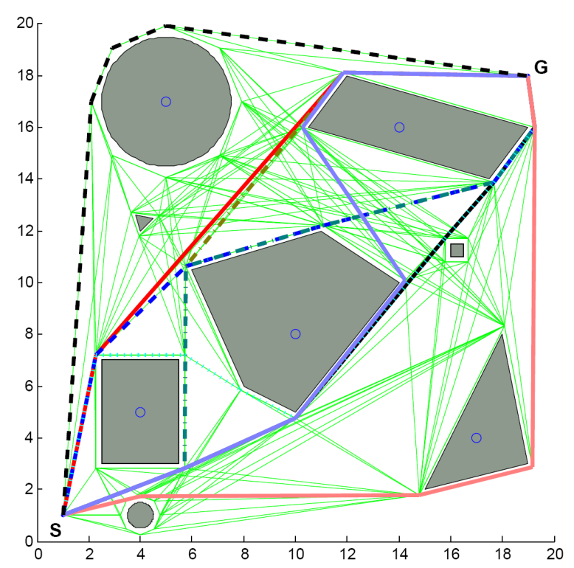
Advantages:
Can be readily integrated in standard graph searches ( A*, D*, ARA*, etc search in discritized environments, visibility graphs, roadmaps)
Elegant
Efficient – scales well
Can deal with non-Euclidean cost functions and additional graph dimensions
Exploring homotopy classes in a large 1000x1000 uniformly discretized environment
Implementation on a Visibility Graph

Slide 5
More at the poster:
Details on the theory
Graph construction
Algorithmic details
Insight into graph topology
Interesting results and applications
Please stop by!!
Thank you.

